Slide 1
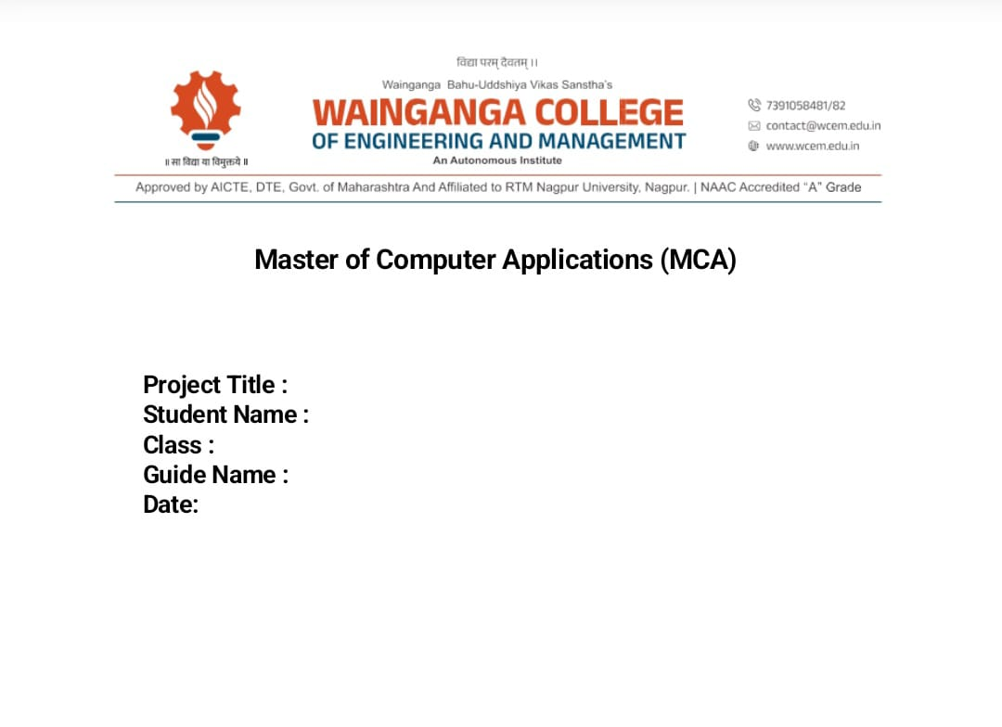

Stock Market Price Prediction using ML
Dhiraj Gopal Napte
MCA II
Dr. Deepali Bhende

Slide 2
Title : Stock Market Price Prediction using Machine Learning
Subtitle: A Deep Learning approach using LSTM
(Long Short-Term Memory)
Presented by: Dhiraj Gopal Napte
College: Wainganga College of Engineering and Mangement.

Slide 3
Introduction
The stock market is a complex, non-linear system.
Predicting prices helps investors minimize risks.
Problem: Traditional models fail to capture long-term dependencies in time-series data.
Solution: Use Machine Learning (Deep Learning) to identify patterns in historical data.

Slide 4
Objectives
To collect real-time stock data using the Yahoo Finance API.
To preprocess and normalize data for neural network training.
To implement an LSTM model for time-series forecasting.
To visualize the accuracy by comparing "Actual" vs. "Predicted" prices.

Slide 5
System Requirements
Language: Python 3.xLibraries:
* Keras/TensorFlow (Model Building)
pandas & NumPy (Data Handling)Matplotlib (Visualization)yfinance (Data Source)

Slide 6
Methodology (The LSTM Model)
Why LSTM? Unlike standard neural networks,
LSTMs have "memory cells" to store information from the past.
Gates: It uses Input, Forget, and Output gates to decide which data to keep or discard.
Windowing: The model looks at the last 60 days of closing prices to predict the price of the next day.

Slide 7
Project Workflow
Data Collection: Fetching ticker data (e.g., GOOGL).
Preprocessing: Scaling data to a range of (0, 1) using MinMaxScaler.
Training: Feeding 80% of data into the LSTM layers.Testing: Using the remaining 20% to validate the model.
Output: De-normalizing data to show actual price values.

Slide 8
Key Code Snippet
(Include a screenshot of the model.
add(LSTM(...)) section from the code I gave you earlier)
Features: 2 LSTM layers, Dropout layers (to prevent overfitting),
and 1 Dense output layer.

Slide 9
Results & Discussion
The model successfully tracks the "trend" of the stock.
Performance Metric: Mean Squared Error (MSE) was used as the loss function.
Observation: The model is excellent at identifying momentum but cannot predict sudden market crashes or news-based volatility.

Slide 10
Advantages & Future Scope
Advantages: Automates analysis, handles large datasets,
and works for any stock ticker.
Future Scope: * Adding Sentiment Analysis (News/Twitter data).
Integrating more features like Volume and RSI (Technical Indicators).

Slide 11
Conclusion & References
LSTM is a powerful tool for time-series prediction.
Machine learning provides a data-driven edge in financial
decision-making.
References: Yahoo Finance, TensorFlow Documentation, Scikit-learn.

Slide 12
THANK YOU!

